Slide 1

Student Details
Name – Tannu
SkillsBuild Email ID – sangwantannu1234@gmail.com
College Name – Manav Rachna University, Faridabad
College State – Haryana
Internship Domain – Front End Development
Internship Start & End Date – 12th June, 2023 to 24th July,2023

Slide 2
PROJECT TITLE/Problem Statement
Title:
Website Clone of Amazon
Problem Statement:
The goal of this project is to create a functional and visually appealing website clone of the popular e-commerce platform Amazon. The clone should replicate key features and functionalities of Amazon's website’s homepage while incorporating a user-friendly design and intuitive navigation. The primary objective is to provide users with a seamless online shopping experience, simulating the convenience and variety offered by the original Amazon platform.

Slide 3
AGENDA
The agenda of creating a website clone of Amazon is to replicate the key features and functionalities of the original Amazon website in order to provide users with a similar online shopping experience.
The primary objectives of developing such a clone are as follows:
E-commerce Experience
User Convenience
Learning and Practice
Showcase Technical Skills
Business Opportunities
Customization and Experimentation
Proof of Concept

Slide 4
PROJECT OVERVIEW
Introduction:
The Amazon Clone Website project aims to create a functional and feature-rich e-commerce platform that replicates key elements of the popular online marketplace, Amazon. This project is intended to provide users with a familiar online shopping experience similar to Amazon while allowing developers to showcase their technical skills in web development and design.
Technology Stack:
Used appropriate technologies for frontend development (HTML, CSS, JavaScript)
Homepage Frontend Overview:
Header:
Design a clean and easily navigable header that includes the Amazon logo and a search bar to allow users to search for products quickly.
Add navigation links to essential sections such as "Home," "Shop by Category," "Sign In/Sign Up," "Cart," etc.
Hero Section:
Create an attractive hero section showcasing high-quality images or banners with eye-catching taglines and offers.

Slide 5
PROJECT OVERVIEW Continued…….
3. Deals and Offers:
Highlight ongoing deals, discounts, and special offers to attract users' attention.
Use banners or cards to showcase limited-time promotions.
4. Footer:
Design a footer that contains links to important pages such as "About Us," "Contact Us," "Privacy Policy," etc.
Include social media icons for users to connect with the website on various platforms.
Future Scope:
Since I have completed the homepage frontend, I can now focus on expanding the project to include other crucial pages and functionalities like product detail pages, shopping cart, checkout, user profile, etc., Also, I can Connect the frontend to a backend server and database to fetch and display real product data.

Slide 6
WHO ARE THE END USERS of this project?
The end users of the Amazon Clone Website project can be categorized into two main groups:
Shoppers / Customers: Shoppers and customers are the primary end users of the website. As end users, they interact with various features and functionalities of the website, such as:
Searching for products based on keywords or categories.
Exploring product listings and details, etc.
2. Admins / Website Administrators: Website administrators are the secondary end users responsible for managing the website and its operations. They have access to the website's backend and administrative functionalities, allowing them to:
Add, update, or remove products from the database.
Manage product categories and subcategories.
View and manage customer orders and transactions.
This will be possible after implementing the backend functionalities.

Slide 7
YOUR SOLUTION AND ITS VALUE PROPOSITION
The frontend development of the Amazon Clone aims to create a visually appealing, user-friendly, and feature-rich e-commerce website that replicates the key elements of Amazon's frontend while incorporating modern web development practices.
Home Page:
Design an engaging homepage with a captivating hero section, showcasing featured products, deals, and promotions.
Include product category sections and product cards with compelling images and brief descriptions.
Value Proposition of the Solution:
Familiar User Experience.
Showcase of Skills
Learning and Practice
Potential Business Venture

Slide 8
How did you customize the project and make it your own
There are various ways by which I can customize this project to make it my own. Some of these are as follows:
Design and Branding: Customize the visual design of the website by incorporating my own color scheme, logo, and branding elements.
Feature Additions: By adding unique features or functionalities that are not present in the original Amazon website. For example, I could integrate a rewards program, personalized recommendations, or interactive elements to enhance the user experience.
Social Integration: I can implement social media integration to allow users to share products or reviews on social platforms, further increasing the website's visibility.
Performance Optimization: I can optimize the website's performance to ensure fast loading times and smooth interactions. Users appreciate a fast and responsive website.
Localization: I can customize the project to cater to specific regions or languages. I can provide support for multiple currencies, shipping options, and regional-specific content.

Slide 9
MODELLING
The modeling of the frontend development for the Amazon Clone homepage will focus on the layout, components, and interactions involved in creating a visually appealing and user-friendly home page.
1. HTML Structure:
Use HTML to define the basic structure of the homepage.
Create header, main content section, footer, and other necessary elements.
2. Header:
Design a header section containing the Amazon logo and navigation links.
Include a search bar for users to search for products.
3. Hero Section:
Create a hero section with a large banner showcasing featured products or promotional offers.
4. Product Categories:
Implement a grid or carousel layout to display different product categories (e.g., Electronics, Fashion, Home & Kitchen).
5. Deals and Offers:
Add a section to showcase ongoing deals, discounts, or special offers.
Use banners or cards to attract users' attention to limited-time promotions.

Slide 10
MODELLING Continued…..
6. Footer:
Design a footer containing links to essential pages (e.g., About Us, Contact Us, Privacy Policy).
7. Interactive Elements:
Implement interactive elements like image sliders, hover effects, and smooth scrolling to enhance user experience.
8. Styling:
Apply CSS to style the homepage components, ensuring consistency and visual appeal.
9. Optimization:
Optimize images and other assets for faster loading times and better performance.

Slide 11
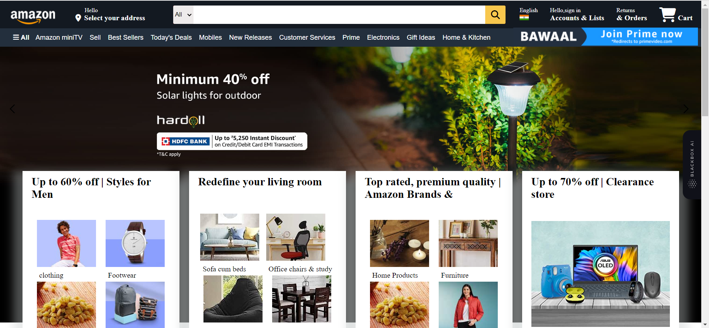
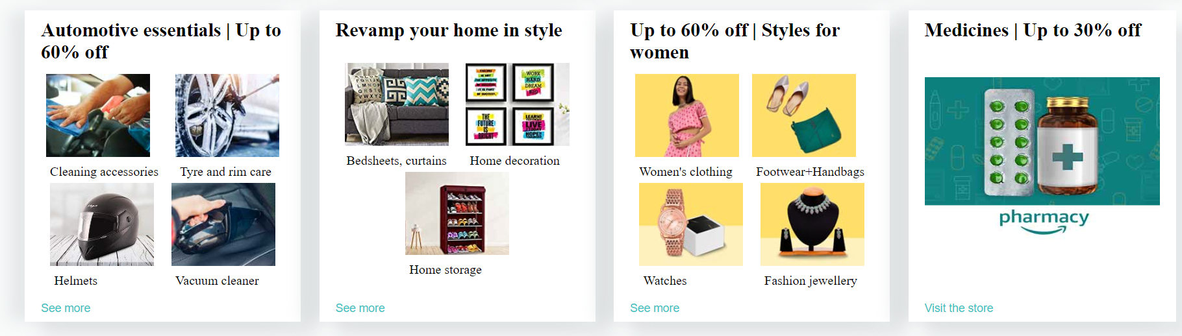
Results

Slide 12
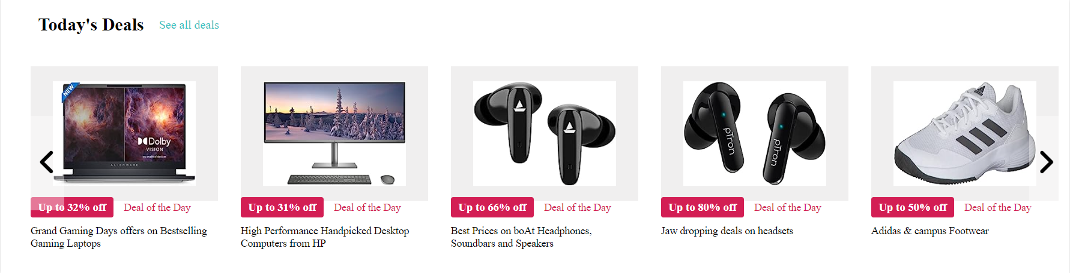
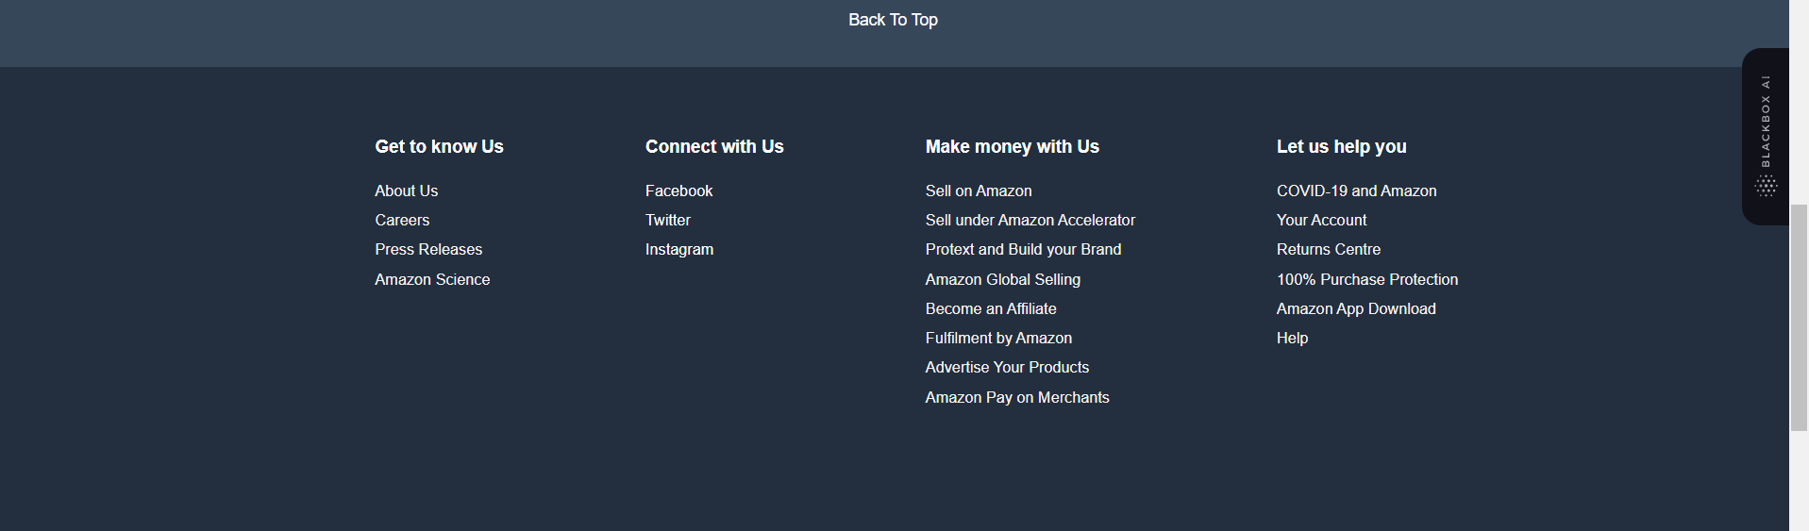
Result screenshots continued….

Slide 13
links
Amazon Website link -> https://www.amazon.in/
Amazon Clone link ->

